Slide 1
KEYWORDS AND IDENTIFIERS

Slide 2
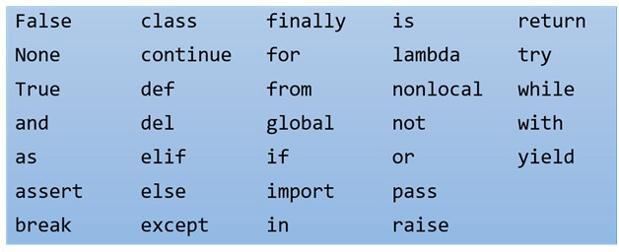
KEYWORDS
A word having special meaning reserved by a programming language is called a keyword.
Since Python knows these words (the meanings of these words) already, we must not use these words as names of variables (identifiers).
All the Python keywords contain lowercase letters only (except for True, False and None).

Slide 3
IDENTIFIERS
(VARIABLE NAMES)
Names of variables are called identifiers.
Names of individuals is the identity of that individual. In the same way, variable names are called identifiers because they identify or give an identity to a variable.
NAMING RULES
Identifiers can consist of letters (A-Z and a-z) and numbers(0-9) and only one special symbol is allowed (underscore _).
An identifier cannot start with a number. It cannot contain any other special character other than underscore.
Identifiers are case-sensitive.
Identifiers must not be keywords.

Slide 4
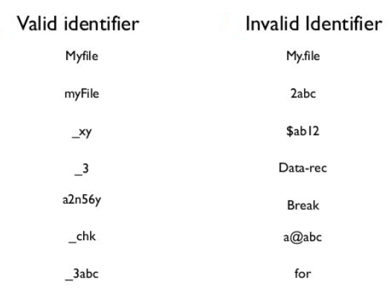
VALID AND INVALID IDENTIFIERS

Slide 5
Happy Learning!

